Slide 1
Child and Dependent Care Credit
Pub 4012 – Tab G
Pub 4491 – Lesson 22
Notes:
The first slides cover the core material for Child and Dependent Care Credit
There are many more slides than are needed for Instructors to present this tax topic
Instructors should choose those slides necessary to prompt discussion depending on the experience level of their volunteers
Key Slides for new Volunteers include: 3-8, and 11-18
For returning volunteers only slides 3, 10, 12, and 15-22 may be needed to prompt discussion
This slide set can also be a good review resource for those certifying through self-study
The following comprehensive topic for Child and Dependent Care Credit is at the end of the presentation:
Slides 29-34: Married Filing Separately Exception

Slide 2
Lesson Topics
Child and dependent care credit rules
Qualifying individual
Earned income requirement and exceptions
Caregiver requirements
Calculating the credit
Comprehensive topic
When MFS allowed to claim credit

Slide 3
Types of Credits
Credits reduce tax liability dollar for dollar
Nonrefundable credits
Limited to tax liability
Cannot reduce tax liability below $0
Refundable credits
Can reduce tax liability below $0
Entered in payment section of Form 1040

Slide 4
Child and Dependent Care Credit
Pub 4012 Tab G
Nonrefundable credit
Review Pub 4012 to Tab G
“Who is a qualifying person?”
“What are qualified work-related expenses?”
Notes:
Qualifying Person:
A qualifying child who was under the age of 13 when the expenses were incurred and who can be claimed as a dependent, see the first caution below
Any person who was incapable of self-care whom the taxpayer can claim as a dependent or could’ve been claimed as a dependent except that the person had gross income of more than $4,150 or filed a joint return or that the taxpayer or spouse, if married filing jointly, could be claimed as a dependent on someone else’s 2018 return
A spouse who was physically or mentally incapable of self-care
Qualified work-related expenses:
Expenses must be paid for the care of the qualifying person to allow the taxpayer and spouse, if married, to work or look for work
The care includes the costs of services for the qualifying person’s well-being and protection
Expenses to attend kindergarten or a higher grade aren’t an expense for care
Expenses for summer day-camp are qualifying, but those for overnight camp aren’t

Slide 5
General Rules
Expenses paid for taxpayer and spouse to work or look for work
Expenses paid for care – not education
Both taxpayer and spouse (if MFJ) must have earned income
Unless incapable of self-care or full-time student
Special rule for deceased spouse
Cannot file MFS (exceptions – comprehensive)
Notes:
Instructors can use this slide to review and reinforce the information following the volunteers’ review of Pub 4012 Tab G
Note there is a special section on the Form 2441 if taxpayer or spouse is incapable of self-care or a student.
MFS discussion is a comprehensive topic discussed at the end of this presentation. There are two rare exceptions.

Slide 6
Qualifying Person Rules
Taxpayer’s dependent qualifying child under age 13 or
Qualifying person incapable of self-care
Spouse
Dependent qualifying child
Would have been taxpayer’s dependent
Exceptions – next slide
Qualifying person must live with taxpayer more than half the year
Credit goes to custodial parent if custodial parent pays expenses
Notes:
Instructors can use this slide to review and reinforce the information following the volunteers’ review of Pub 4012 Tab G
Under age 13 at time of care—not based on age at end of year
Claim expenses incurred up to age 13
Incapable of self-care: cannot dress, clean, or feed themselves. Also persons who must have constant attention to prevent them from injuring themselves or others. This would definitely include young children—probably anyone under age 13
Can be spouse, qualifying child or qualifying relative...plus additional people

Slide 7
Dependency Exceptions
Individual would have been a dependent except
Individual filed MFJ or
Individual’s gross income over threshold amount or
Taxpayer could be claimed as a dependent on another’s return
Notes:
Note that the support test has not been waived
If you pay for care for someone who provides more than half his own support (from social security, for example), this credit is not available

Slide 8
Qualified Expense Rules
Care below kindergarten
After school care – if not educational
Day camp – no overnight camp
Adult day care
In-home care – including some household services
Only one tax benefit allowed – if expenses both dependent care and medical deduction, select most advantageous
Notes:
Instructors can use this slide to review and reinforce the information following the volunteers’ review of Pub 4012 Tab G
Kindergarten used to be included. It was removed a few years ago
Some in-home care may be used as either medical expense or dependent care—not both. NO DOUBLE DIPPING!
Wages and employment taxes for household employee is an allowed expense; however, it is out of scope
Household services that are at least partly for the well-being and protection of a qualifying person are ok. [includes housekeeper, maid, or cook—but not a chauffeur or gardener]
From Instructions to Form 2441:
Care includes the cost of services for the qualifying person's well-being and protection. It does not include the cost of food, lodging, education, clothing, or entertainment.
You can include the cost of care provided outside your home for your dependent under age 13 or any other qualifying person who regularly spends at least 8 hours a day in your home. If the care was provided by a dependent care center, the center must meet all applicable state and local regulations. A dependent care center is a place that provides care for more than six persons (other than persons who live there) and receives a fee, payment, or grant for providing services for any of those persons, even if the center is not run for profit.
You can include amounts paid for items other than the care of your child (such as food and schooling) only if the items are incidental to the care of the child and cannot be separated from the total cost. But do not include the cost of schooling for a child in kindergarten or above. You can include the cost of a day camp, even if it specializes in a particular activity, such as computers or soccer. But do not include any expenses for sending your child to an overnight camp, summer school, or a tutoring program.

Slide 9
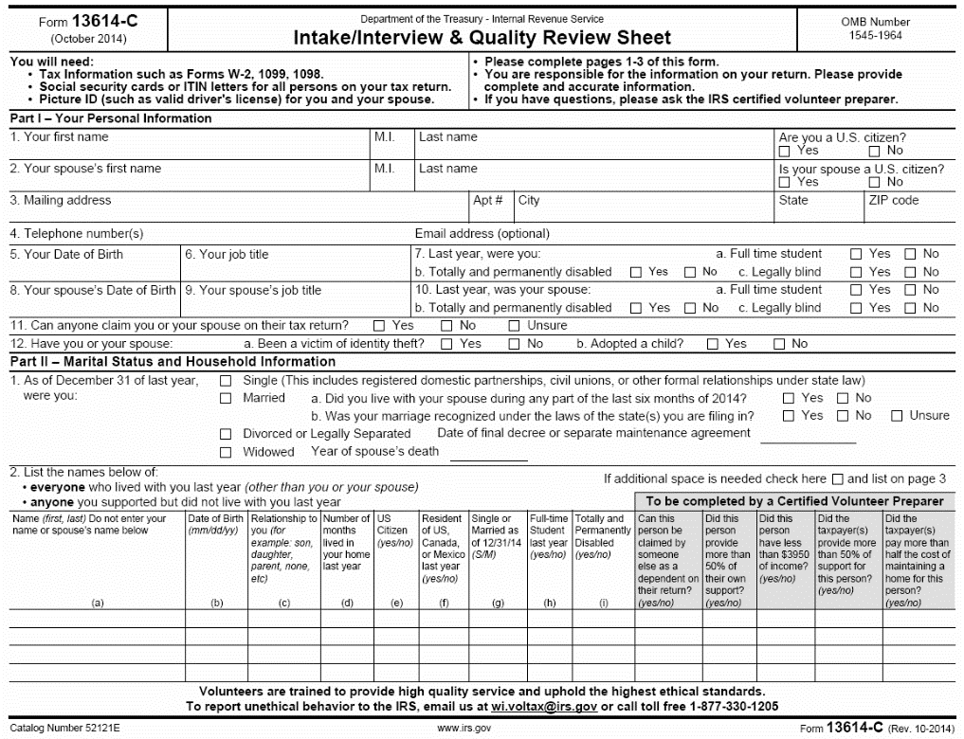
Intake Booklet
Pub 4012 Tab G
Find Child and Dependent Care Credit Expenses in Pub 4012 Tab G
Definition of incapable of self-care
Being disabled may be an indicator of needing care and useful if filing MFJ
Notes:
What are hints that this credit might apply?
Note “Disabled” is not enough – the criteria is that the person be “incapable of self-care” so probing questions need to be asked. Many people who are disabled in some manner are still capable of self care.
Incapable of self-care: Physically or mentally not able to care for oneself. Persons who cannot dress, clean, or feed themselves because of physical or mental problems are considered not able to care for themselves. Also, persons who must have constant attention to prevent them from injuring themselves or others are considered not able to care for themselves.
Permanently and totally disabled: A person is permanently and totally disabled if both of the following apply:
He or she cannot engage in any substantial gainful activity because of a physical or mental condition.
A doctor determines the condition has lasted or can be expected to last continuously for at least 12 months or can lead to death.

Slide 10
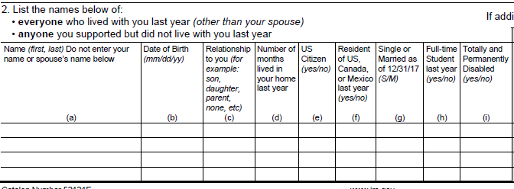
Intake/Interview
Intake Booklet
Under age 13?
Being disabled may be an indicator of needing care if age 13 or older
More than 6 months?
Notes:
Qualifying children under 13 qualify up until their 13th birthday – calculate partial year
If dependent is incapable of self-care, qualify at any age. Note “Disabled” is not enough – the criteria is that the person be “incapable of self-care” so probing questions need to be asked. Many people who are disabled in some manner are still capable of self-care.
See definitions for disabled and incapable of self-care on back of trifold
See: https://www.irs.gov/instructions/i2441/ar01.html#d0e71, also Pub. 501, Exemptions, Standard Deduction, and Filing Information

Slide 11
Intake Booklet
Did taxpayer or spouse pay for dependent care (or night care) while they worked or looked for work?
Notes:
Day care expense includes care for kids and for adults who are incapable of self-care
This person doesn’t have to be your dependent, so taxpayer may not mark the intake form correctly.
Ask if an in-home caregiver is taxpayer’s employee—as opposed to an independent contractor. If so, and total payments were more than $2000, then Schedule H for household employees is required, and the return is out of scope.

Slide 12
Determining eligibility for the credit
Open Pub 4012 Tab G Credit for Child & Dependent Care Expenses – Screening Sheet and note:
The steps for general rules
The steps that pertain to “allowable” caregivers
Refer to Qualifying Child/Qualifying Relative Tri-Fold
Note those sections that pertain to Child and Dependent Care Credit (blue section)

Slide 13
Caregiver Rules
Cannot be spouse or dependent
Cannot be taxpayer’s child under age 19
Cannot be child’s parent (with some exceptions for adults needing care)
Provide name, address and identifying number
Taxpayer must use due diligence to get information
Notes:
Instructors can use this slide to review and reinforce the information following the volunteers’ review of Pub 4012 Tab G Screening Sheet
If you can’t get the EIN, SSN or ITIN for the provider you cannot e-file and must complete an explanation on the back of Form 2441.
If caregiver is your employee, and total payments were more than $2000, then Schedule H for household employees is required, and return is out of scope.

Slide 14
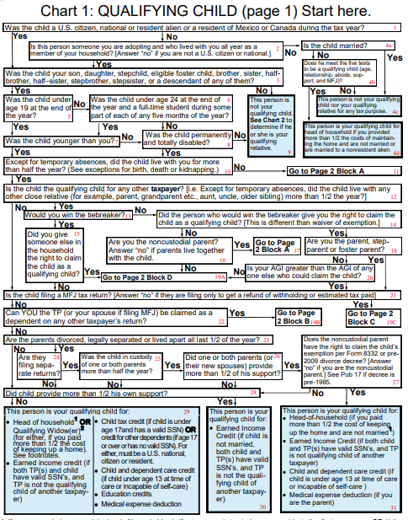
Qualifying Child Chart
Use Tri-Fold to determine eligibility – especially when qualifying person is not straightforward
Examples
Notes:
The QC/QR Tri-Fold can be a very useful tool for determining eligibility for this credit, especially in cases where the qualifying person is not straightforward
Lots of different routes to this credit
It is best to have a copy of the QC/QR Tri-Fold in hand in order to follow the information in these slides.

Slide 15
Employer-provided Benefit
Deduct employer-provided expenses from taxpayer’s expenses
Taxpayer claims net out of pocket expenses
TaxSlayer automatically deducts Form W-2 box 10 amount
Enter total paid by taxpayer (before employer reimbursement) on Form 2441 Page 1 input form
Notes:
These appear on W-2 Box 10 and are included in income on Line 7 until Form 2441 is completed
If benefits were received that are not on Form W-2, enter the amount on TaxSlayer Form 2441 page 2
Amounts on Form 2441 Part II – 2(a) must not show more than the net amount of expenses paid

Slide 16
Calculating the Credit
Credit is 20% – 35% of qualifying expenses
Percentage based on AGI
Maximum expense amount eligible for credit
$3,000 one qualifying person
$6,000 two or more qualifying persons
Does not matter for which qualifying person amount is spent
Limited to the lesser of taxpayer’s or spouse’s earned income (or deemed earned income)
Notes:
TaxSlayer makes all calculations.
If more than one qualifying person, ALL $6,000 can be spent on one of the qualifying people

Slide 17
Calculating the Credit – Example 1
Married taxpayers earned $30,000 each during the year and have 2 qualifying children
One child is cared for at no expense by neighbors
The second child had qualifying day care expenses of $10,000 during the year
What expense amount is used to calculate the child and dependent care credit?

Slide 18
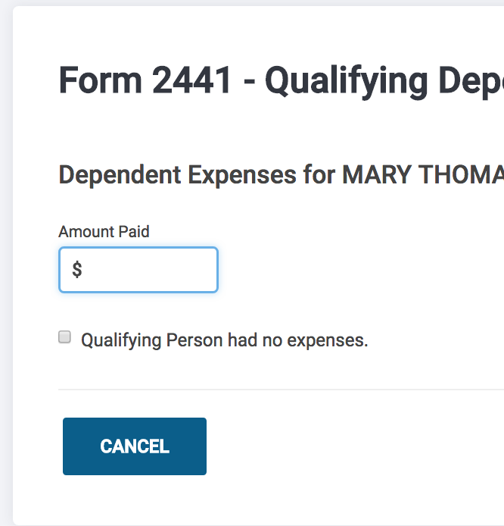
Calculating the Credit – Example 1
$6,000
Even though there are no out of pocket expenses for the first child, they have two children that qualify for the child and dependent care credit. Check the box for the second child with no expenses.
Notes:
Learners can find this in Pub 4012 page G-7 at the bottom of the page as a caution

Slide 19
Earned Income Requirement
Taxpayer or spouse can have deemed earned income if a full-time student (at least 5 months during the year) or incapable of self-care
$250 per month ($500 if care is for more than one qualifying person)
Taxpayer or spouse can have deemed income in a given month but not both
Use actual earned income if higher
Notes:
If the taxpayer or spouse is a full-time student (at least 5 months) or is incapable of self-care, they are deemed to have earned income of $250 for each month they are full-time student or incapable of self-care($500 if more than one qualifying person was cared for)
If taxpayer and spouse are full-time students or incapable of self-care, in a month, only one can have the deemed earned income
If the student or incapable of self-care TP or SP also worked, use the higher of the deemed amount or their actual compensation

Slide 20
Earned Income Requirement
Surviving taxpayer filing MFJ in year of spouse’s death
Can use only surviving spouse earned income
Beneficial if deceased spouse had little or no earned income
Notes:
Pub 503 Child and Dependent Care Expenses

Slide 21
TaxSlayer Entry – Incapable of Self-Care
Enter “disabled” in TaxSlayer (must be incapable of self-care)
Dependent screen
Form 2441 Qualifying person not listed on 1040 screen

Slide 22
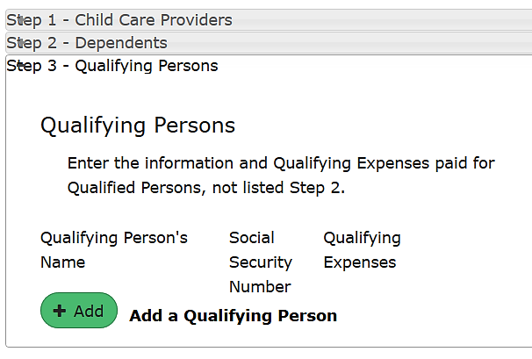
TaxSlayer – Qualifying Person Not a Dependent
If not listed in dependent section, can add qualifying person on Form 2441
Notes:
For example a spouse not capable of self-care

Slide 23
Schedule 3 Nonrefundable Credits
Form 2441 Credit for child and dependent care expenses entered on Form 1040 Schedule 3

Slide 24
Quality Review
Verify care was for taxpayer to work or look for work
Verify deemed income for incapable of self-care or student spouse was entered correctly
Verify surviving spouse’s earned income used for deceased spouse if beneficial

Slide 25
Quiz 1
Mary and Tom file MFJ
Mary is a stay-at-home mom
When she needed to travel to take care of her own parents, Mary and Tom paid for day care for their kids
Can they claim the dependent care credit for this expense?
No – payment was not so Mary could work or look for work

Slide 26
Quiz 2
Maria’s husband Jose has dementia and cannot be left at home alone
She takes him to an adult day care at the local hospital each day on her way to work
Can they claim the dependent care credit even though Jose does not work?
Yes – Complete TaxSlayer Form 2441 Step 3 – Add a qualifying person incapable of self-care spouse

Slide 27
Quiz 3
Young Amanda lives with her mother
As part of the divorce decree, her father Jack agreed to pay for Amanda’s day care while her mother works
Amanda’s mother has signed Form 8332 so that Jack can claim Amanda’s exemption
Who can claim the dependent care credit?
No one. Amanda did not live with Jack for six months, so he cannot claim it; and Amanda’s mother did not pay it, so she cannot claim it

Slide 28
Child and Dependent Care
Questions?
Comments?

Slide 29
Child & Dependent Care – Comprehensive Topics
Married Filing Separately Exception
Notes:
Comprehensive topics

Slide 30
MFS Allowed to Claim Credit
Married and not filing with spouse
Taxpayer not qualified for HoH filing status
Taxpayer paid over half the cost of maintaining the home for unrelated child or person incapable of self-care
Qualifying person lived with taxpayer more than half the year
Qualifying person not being claimed by another taxpayer

Slide 31
MFS Allowed to Claim Credit
Care was for deceased taxpayer
Spouse has subsequently remarried
Filing MFJ with new spouse
Deceased taxpayer files MFS
Can claim credit for their own care

Slide 32
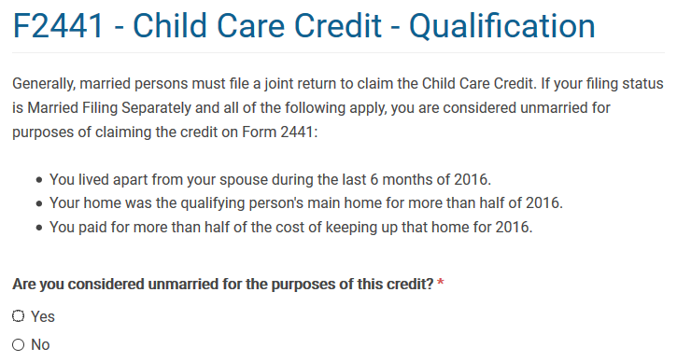
MFS Allowed to Claim Credit
Must answer “yes” if allowed to claim the credit
Notes:
This screen may show in the credits menu – 2441 (when already MFS) or at basic information (when changing to MFS status and already have CDC info entered)

Slide 33
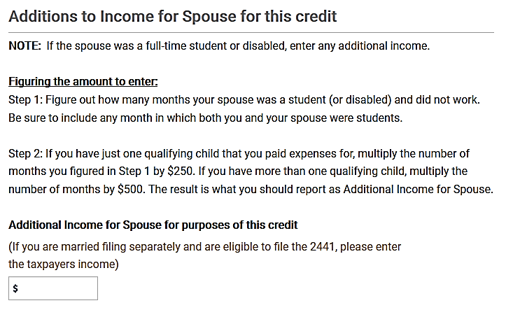
MFS Allowed to Claim Credit
Enter Taxpayer’s earned income manually. TaxSlayer will not calculate.
Notes:
Enter Taxpayer’s earned income manually. TaxSlayer will not calculate.

Slide 34
Child and Dependent Care
Questions?
Comments?

